Slide 1

Rechnerarchitekturen für Deep-Learning Anwendungen (RADL)
Dustin Heither, Maximilian Achenbach, and Robert Kagan
Optimizing Deep Learning Performance:
A Hybrid CPU-GPU Framework with Multithreading, SIMD,
and Evaluation of Efficiency Metrics

Slide 2
Outline
5. Presentation
01
Tweaks & Enhancements
02
Hardware & Benchmark
03
CUDA Tuning
04
Multithreading & SIMD
05
Quantization
06
Outlook

Slide 3
Tweaks & Enhancements
Overview
Build System Enhancements:
Goal: Support new compiler flags
Solution: Updated make config
Data Preprocessing:
Goal: Avoid repeated transposing
Solution: Pre-transposed fc_bias and fc_weights
Function Inlining:
Goal: Minimize overhead caused by function calls
Solution: Inlined all remaining functions
Optimization Flags:
Goal: Enable optimizations and detect memory issues
Solution: Integrated -O3 and -fsanitize=address
AVX-512 Optimization:
Goal: Avoid repeated inline assembly runtime checks for AVX-512
Solution: Relocated the checks for AVX-512 to the Makefile

Slide 4
Hardware & Benchmark
Hardware
CPU | Release date | TDP (W) | Number of (performance) cores | Number of threads
AMD Ryzen 7 3800XT | 7. Juli 2020 | 105 | 8 | 16
Apple M3 Pro 11-Core | 30. Oktober 2023 | 27 | 5 | 11
Intel Core i7 1065G7 | 1. Juni 2019 | 15 | 4 | 8
GPU | Release date | TDP (W) | Number of CUDA cores | Base Clock (MHz)
NVIDIA GeForce RTX 2080 | 20. September 2018 | 215 | 2944 | 1515
NVIDIA GeForce MX350 | 10. February 2020 | 20 | 640 | 1354

Slide 5
Hardware & Benchmark
Benchmark
Batch size: 1
Epochs: 128
Unit:
Total time
In microseconds (µs)
⚠️ Averaged over 12 runs
⚠️ Discarding first 2 runs
Lower is better
Old:
Last presentation
Quantization:
Data type: int8
XL:
Image dimensions: (32x30)²

Slide 6
CUDA Tuning
Overview
Fixed CUDA Transpose:
Change: Corrected the previously incorrect implementation
Benefit: Ensured accurate functionality and improved code reliability
Implemented CUDA Constant Memory for Conv2D:
Change: Optimized kernel operations using constant memory for frequently accessed data
Benefit: Reduced memory latency and improved execution speed
Implemented CUDA Pipeline:
Change: Introduced efficient pipelining mechanisms for overlapping data transfer and computation
Benefit: Enhanced GPU utilization and throughput
Separated GPU Allocations from CPU:
Change: Decoupled memory management between CPU and GPU
Benefit: Improved resource management

Slide 7
CUDA Tuning
Profiling with nvprof
Key Takeaways
MNIST:
34% matmul
18% conv2d
12% maxpool, biasing, relu
XL:
94% matmul
<2% other functions
Key Insights
matmul becomes the bottleneck in XL
Explanation
matmul complexity: O(n³)
Other functions: O(n²)
Scale factor: 32
Growth Factor:
matmul: 32,768
Other functions: 1024
Goal
Improve matmul computation speed

Slide 8
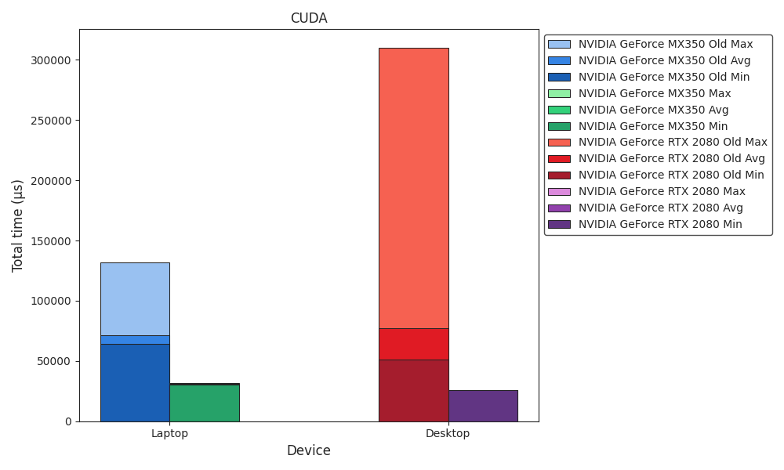
Benchmark
CUDA

Slide 9
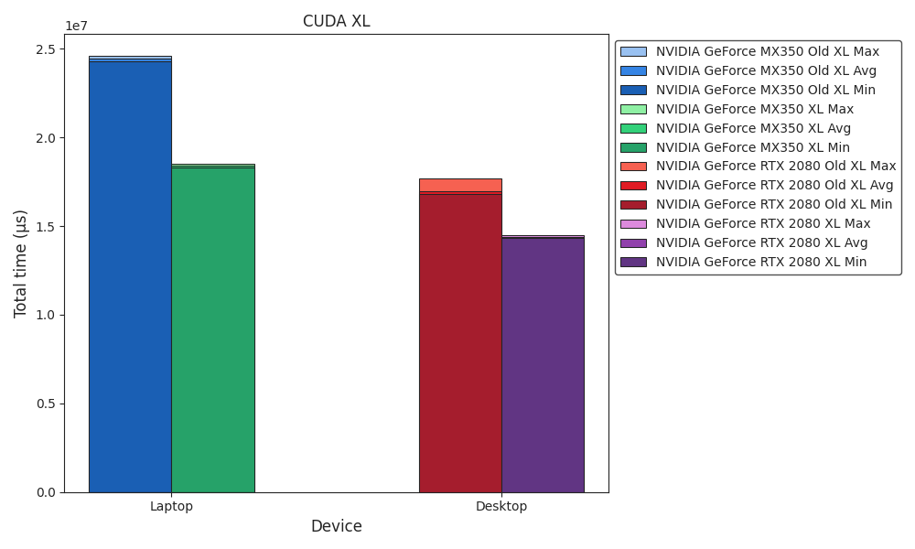
Benchmark
CUDA XL

Slide 10
Multithreading & SIMD
Multithreading
Fixed Memory Leak
Change: Resolved a memory leak that had existed for a long time
Benefit: Reduced memory usage
Enhanced Poison Pill
Change: Removed costly if comparisons
Benefit: Direct thread termination
Optimized mt_arg
Change:
Reduced the size of mt_arg
Moved mt_arg to its own header file
Benefit: Lower memory overhead and improved modularity
Enhanced Multithreading
Change: Improved smart multithreading and thread distribution
Benefit: Better performance and workload balance
Before:
void create_mt(long threads) {
...
mt_arg *mt = (mt_arg*)malloc(THREADS * sizeof(mt_arg));
for(long i = 0; i < THREADS; i++) {
mt[i].idx = i;
pthread_create(&tids[i], NULL, start_mt, &mt[i]);
}
}
static void *start_mt(void *arg) {
mt_arg *mt = (mt_arg*)arg;
while(1) {
mt_arg *head = (mt_arg*)g_async_queue_pop(queue);
if(head->start_routine == stop_mt) {
break;
}
head->idx = mt->idx;
head->start_routine(head);
}
return NULL;
}

Slide 11
Multithreading & SIMD
Multithreading
Fixed Memory Leak
Change: Resolved a memory leak that had existed for a long time
Benefit: Reduced memory usage
Enhanced Poison Pill
Change: Removed costly if comparisons
Benefit: Direct thread termination
Optimized mt_arg
Change:
Reduced the size of mt_arg
Moved mt_arg to its own header file
Benefit: Lower memory overhead and improved modularity
Enhanced Multithreading
Change: Improved smart multithreading and thread distribution
Benefit: Better performance and workload balance
After:
__attribute__((always_inline)) inline void create_mt(int threads) {
...
int idx[THREADS];
for(int i = 0; i < THREADS; i++) {
idx[i] = i;
pthread_create(&tids[i], NULL, start_mt, &idx[i]);
}
wait_mt();
}
__attribute__((always_inline)) inline static void *start_mt(void *arg) {
int idx = *(int*)arg;
wait_mt();
while(1) {
mt_arg *head = (mt_arg*)g_async_queue_pop(queue);
head->idx = idx;
head->start_routine(head);
}
return NULL;
}

Slide 12
Multithreading & SIMD
Multithreading
Fixed Memory Leak
Change: Resolved a memory leak that had existed for a long time
Benefit: Reduced memory usage
Enhanced Poison Pill
Change: Removed costly if comparisons
Benefit: Direct thread termination
Optimized mt_arg
Change:
Reduced the size of mt_arg
Moved mt_arg to its own header file
Benefit: Lower memory overhead and improved modularity
Enhanced Multithreading
Change: Improved smart multithreading and thread distribution
Benefit: Better performance and workload balance
Before (mt.hpp):
typedef struct mt_arg {
long idx;
matrix **a_ptr;
matrix *a;
matrix **b_ptr;
matrix *b;
int len;
matrix **c_ptr;
matrix *c;
...
} mt_arg;
After (mt_arg.hpp):
typedef struct mt_arg {
int idx;
matrix **a;
matrix **b;
matrix **c;
int len;
...
} mt_arg;

Slide 13
Multithreading & SIMD
Multithreading
Fixed Memory Leak
Change: Resolved a memory leak that had existed for a long time
Benefit: Reduced memory usage
Enhanced Poison Pill
Change: Removed costly if comparisons
Benefit: Direct thread termination
Optimized mt_arg
Change:
Reduced the size of mt_arg
Moved mt_arg to its own header file
Benefit: Lower memory overhead and improved modularity
Enhanced Multithreading
Change: Improved smart multithreading and thread distribution
Benefit: Better performance and workload balance
Before:
void add_mt(mt_arg *mt) {
...
for(int i = mt->idx; i < mt->c->x; i += THREADS) {
mt->i = i;
add_simd(mt);
}
wait_mt();
}
After:
__attribute__((always_inline)) inline void add_mt(mt_arg *mt) {
...
for(int i = mt->idx * ((*mt->c)->x / THREADS);
i < ((mt->idx + 1) * ((*mt->c)->x / THREADS)) +
(mt->idx == THREADS - 1 ? (*mt->c)->x % THREADS : 0);
i++) {
mt->i = i;
add_simd(mt);
}
wait_mt();
}

Slide 14
Multithreading & SIMD
SIMD
Progress
Fixed void matmul_simd(mt_arg *mt);
Implemented void conv2d_simd(mt_arg *mt);
AMX Registers
X & Y Registers:
Source registers for computations
Contain 64 floating-point values each
Z Register:
Serves as the accumulator or output registers
Holds a 64x64 floating-point matix
AMX Instructions
Defined in aarch64.h:
Implemented as macros for assembly instructions
Utilize bitmasks (bm) to define instruction behavior
Key instructions:
AMX_SET(); and AMX_CLR();: Define AMX instruction blocks
AMX_LDX(bm); and AMX_LDY(bm);: Load values into X and Y registers
AMX_STZ(bm);: Stores values from the Z register to memory
AMX_FMA32(bm);: Performs fused multiply add (z[j][i] += x[i] * y[j])
Power consumptiom
!!!MISSING!!!

Slide 15
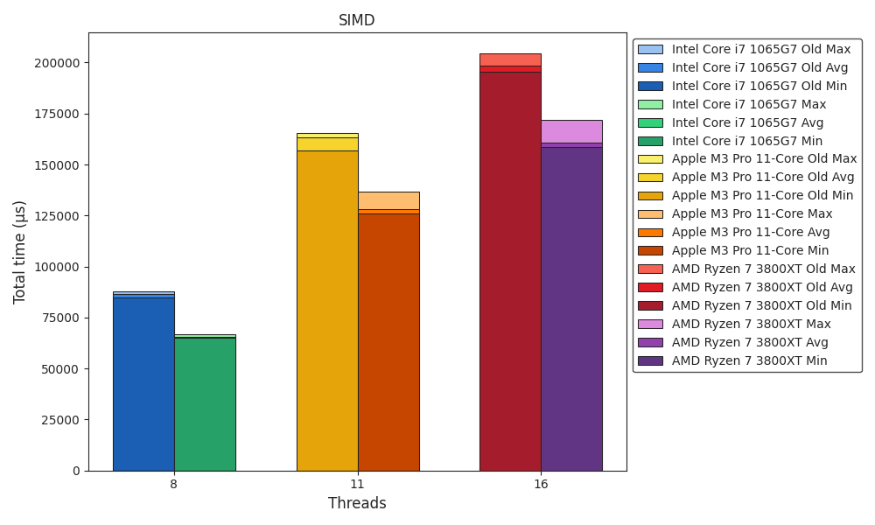
Benchmark
SIMD

Slide 16
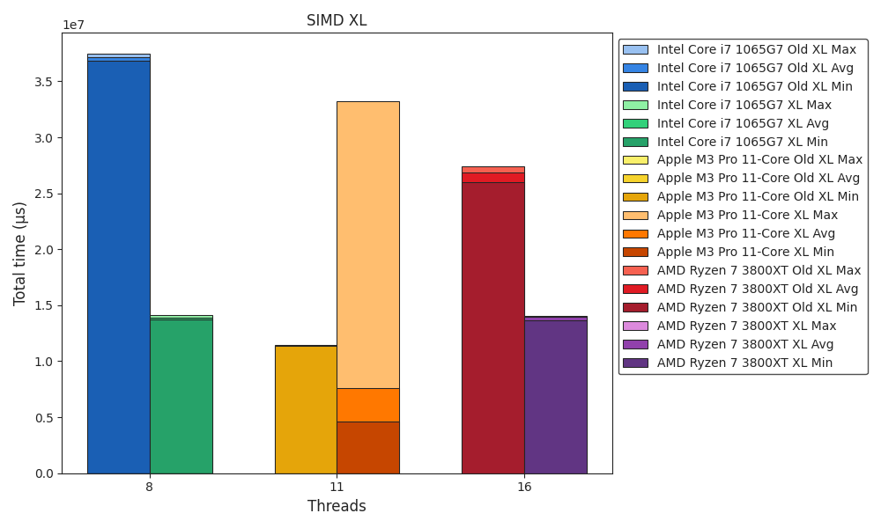
Benchmark
SIMD XL

Slide 17
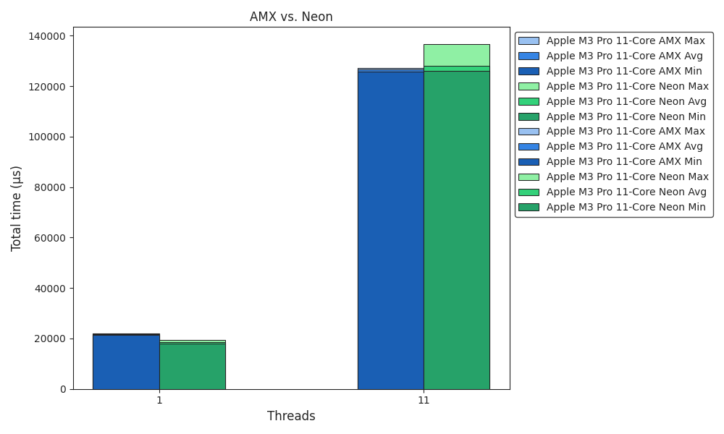
Benchmark
AMX vs. Neon

Slide 18
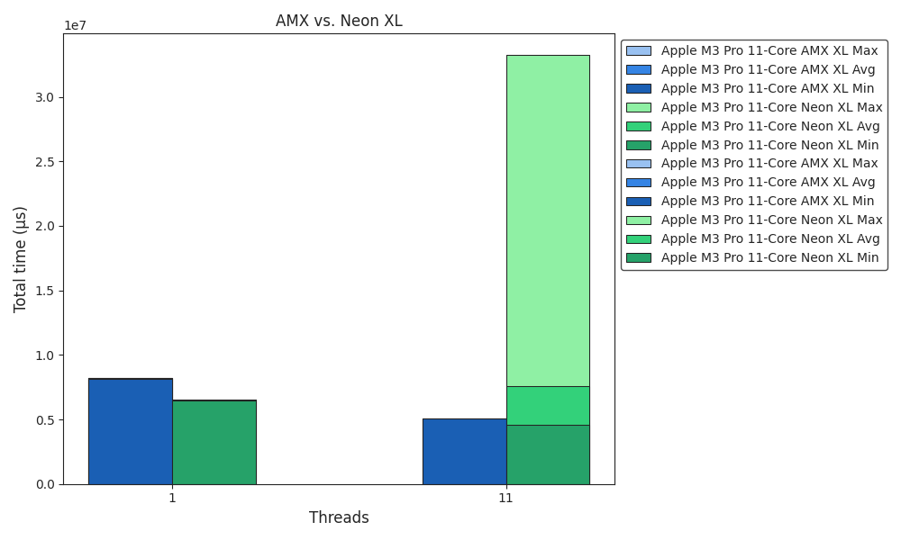
Benchmark
AMX vs. Neon XL

Slide 19
Quantization
Overview
Data Type Optimization
Change: float32 → int8
Benefit: Standard for AI/ML quantization, enabling greater efficiency with minimal accuracy loss
SIMD Integration
Change: Added support for int8 in AVX-512, AVX2, and Arm Neon
Benefit: Process even more elements in parallel, significantly boosting computation speed
Memory Reduction
Change: Model size reduced by ~10% (282.8MB → 253.7MB)
Benefit: Frees up memory on resource-limited devices
__attribute__((always_inline)) inline void matmul_simd(mt_arg *mt) {
#ifdef x86
#ifdef __AVX512F__
#ifdef INT
long CHUNK_SIZE = sizeof(__m256i) / sizeof(DATA_TYPE);
__m256i a, b;
__mmask32 m;
for(int k = 0; k < (*mt->a)->y; k += CHUNK_SIZE) {
m = (__mmask32)((1 << (((k + CHUNK_SIZE) <= (*mt->a)->y) ? CHUNK_SIZE : (*mt->a)->y - k)) - 1);
a = _mm256_maskz_loadu_epi8(m, &amp;(*mt->a)->m[get_idx(mt->i, k, (*mt->a)->y)]);
b = _mm256_maskz_loadu_epi8(m, &amp;(*mt->b)->m[get_idx(mt->j, k, (*mt->b)->y)]);
(*mt->c)->m[get_idx(mt->i, mt->j, (*mt->c)->y)] += _mm256_reduce_add_epi16(_mm256_mullo_epi16(_mm256_cvtepi8_epi16(_mm256_extractf128_si256(a, 0)), _mm256_cvtepi8_epi16(_mm256_extractf128_si256(b, 0))));
(*mt->c)->m[get_idx(mt->i, mt->j, (*mt->c)->y)] += _mm256_reduce_add_epi16(_mm256_mullo_epi16(_mm256_cvtepi8_epi16(_mm256_extractf128_si256(a, 1)), _mm256_cvtepi8_epi16(_mm256_extractf128_si256(b, 1))));
}
...
}

Slide 20
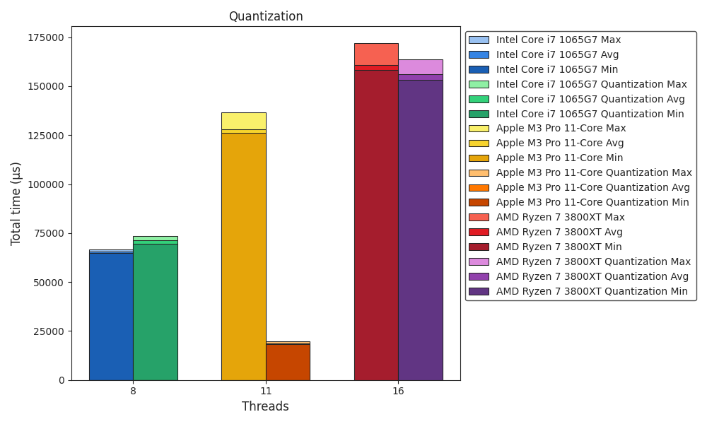
Benchmark
Quantization

Slide 21
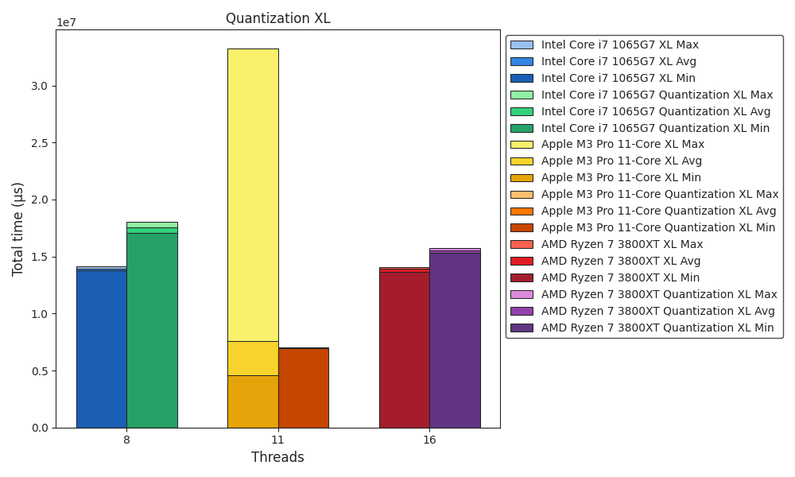
Benchmark
Quantization XL

Slide 22
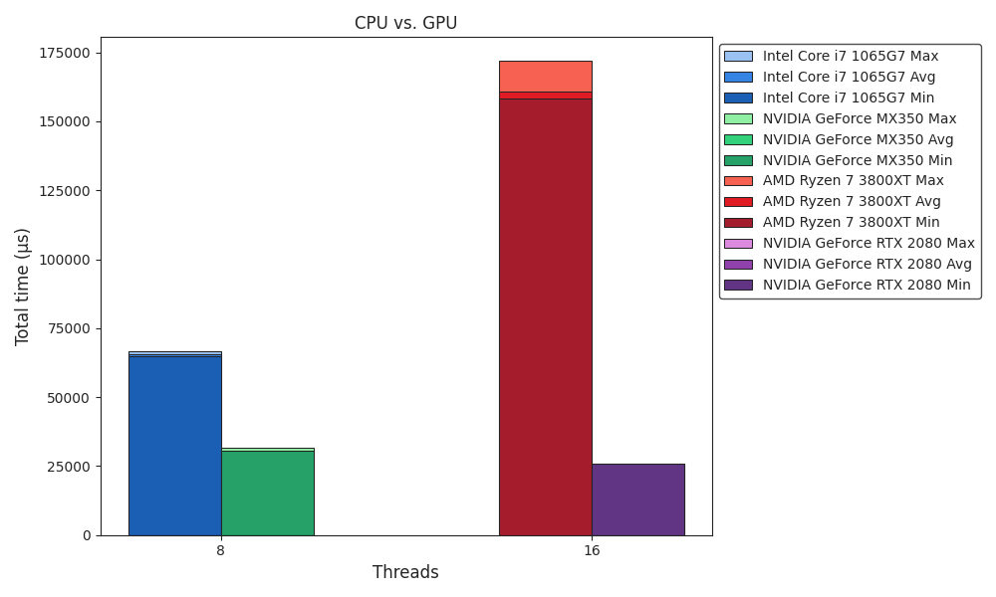
Benchmark
CPU vs. GPU

Slide 23
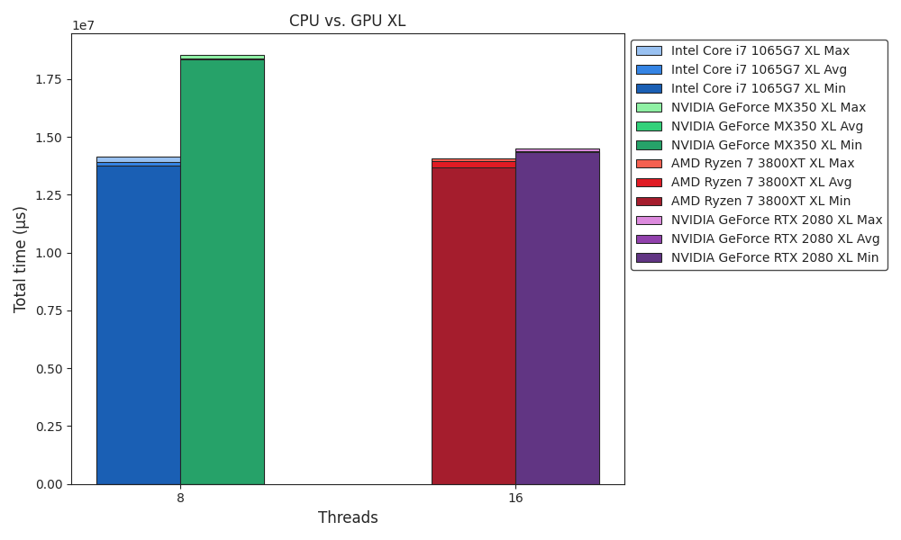
Benchmark
CPU vs. GPU XL

Slide 24
Outlook
Work In Progress
Framework ✅
ICPX vs. Clang ✅
CUDA Tuning ✅
Improve matmul performance
Multithreading ✅
SIMD ✅
Quantization 🚧
Apple AMX
Quantization layer
(OpenMP GPU offload target)
(Apple M3 Pro NPU)

